Slide 1

CodeQuest
MILESTONE 2.0
TEAM A
Notes:
Paniz

Slide 2

Milestone 2.0 goals
Next Features to Implement
Admin Panel: Allow teachers to manage quiz questions
Leaderboard: Show top scores
Improved UI/UX: Add animations, better styling
More Question Categories: Python, SQL, Data Science (Not in Scope)
User Empowerment: Own quiz creation by User (Not in Scope)
Continued Testing: Test script writing (PyTest)
Notes:
Paniz

Slide 3

Milestone 2.0 feature fulfilled
Milestone 2.0 includes:
Student login, Quiz taking and Leaderboard viewing
Teacher login with Admin Panel to manage questions
Custom quiz generation with filters
Export to PDF, Email, Answer Toggle
Notes:
Paniz

Slide 4

User Stories Fulfilled 2.0
Admin Management (CRUD)
As a teacher, I want to add, edit, and delete quiz questions from an admin panel so I can maintain up-to-date content.
Custom Quiz Filtering
As a user, I want to filter quizzes by topic and difficulty so I can generate quizzes that match my learning goals.
Sharing/Exporting Features
As a user, I want to export my quiz to PDF or send it via email so I can study offline or share with others.
User-Friendly UI
As a student or teacher, I want a simple and clean interface so I can focus on the quiz without distractions.
Notes:
Paniz

Slide 5

A message from our client
Amazing job.
Thank you for demoing the project.
We really need the ability to compose custom quizzes.
We are not talking about writing our own questions, we are not qualified to do that (yet).
We would like to be able to click a button to generate a quiz.
We should be able to specify a difficulty level as well as a topic area, but that should be optional - we may just want to click the create quiz button
Notes:
Paniz

Slide 6

Summary of client request
We need the ability to compose custom quizzes.
We should be able to specify a difficulty level as well as a topic area, but that should be optional.
We may just want to click the create quiz button.
Notes:
Paniz

Slide 7
Client request to user stories 1
As a teacher, I want to click a "Generate a Quiz" button so that I can easily create a quiz without writing questions myself.
As a teacher, I want to filter by difficulty so I can customize the quiz based on student levels.
As a teacher, I want to filter by topic to focus the quiz on specific subject areas.
As a teacher, I want to set the number of questions I want in the quiz so I can control quiz length.
Notes:
WIn

Slide 8
Client Request to User Stories 2
As a teacher, I want to preview the generated quiz so I can verify the questions before using it.
As a teacher, I want to show or hide correct answers and explanations so I can customize visibility based on my needs.
As a teacher, I want to export the quiz to PDF so I can print or distribute offline.
As a teacher, I want to email the quiz to myself for record-keeping or sharing with others.
Notes:
WIn

Slide 9

Working code snippets
Here are some sample code snippets behind the key features we will demo.
Registration form includes optional teacher code for role assignment.
Notes:
Win

Slide 10
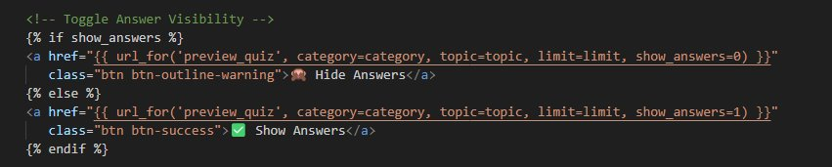
Answer toggling logic
Dynamic rendering of answers using show answers flag.
Notes:
Win

Slide 11
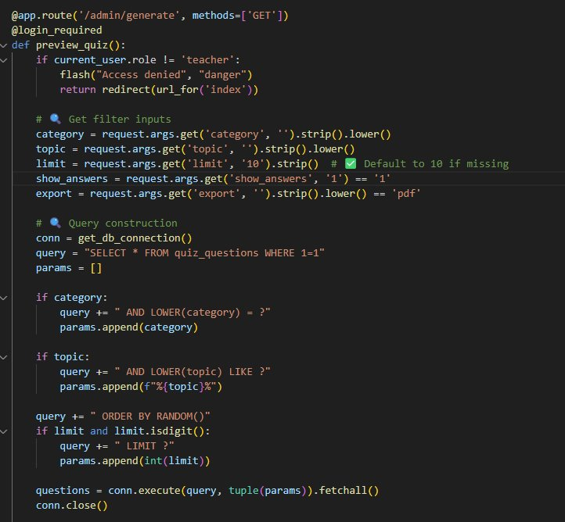
Generate quiz preview
Flask route handling quiz generation and session-based exports.
Notes:
Win

Slide 12
DEMO
Login / Register (Student & Teacher)
Leaderboard
Admin panel with Question Management
Generation of Quiz (Client Request)
Export to PDF
Emailing
Notes:
Win

Slide 13

Agile process & burndown chart
Used Agile development with 4 iterations, each targeting milestone goals.
Weekly team meetings and GitHub issues helped track progress and unblock challenges.
Iteration planning adapted to evolving client needs, especially for the custom quiz feature.
Frequent Git commits ensured version control and collaboration.
Burndown chart tracks planned vs actual progress.
Iteration 4 was added to address the new client feature request.
Notes:
Emmanuel

Slide 14
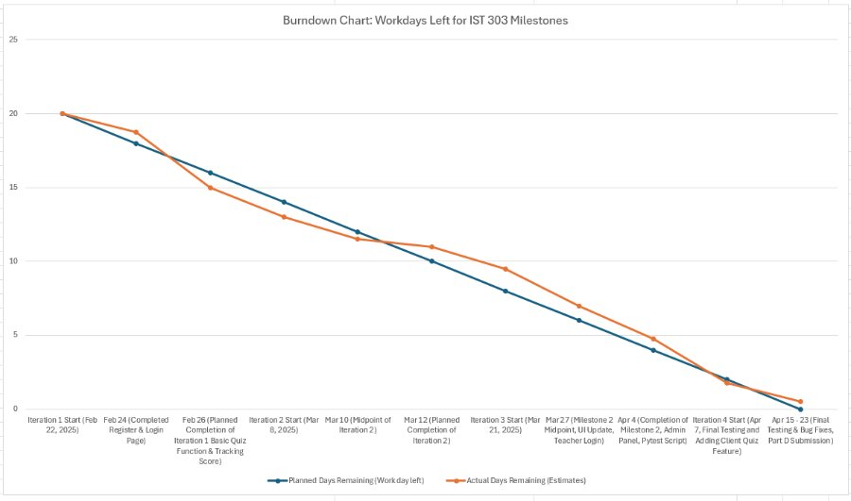
burndown rate
Notes:
Emmanuel

Slide 15
Iteration breakdown
Iteration | Key Deliverables
Iteration 1 | Register/Login, Basic Quiz
Iteration 2 | Quiz Flow, Score, Feedback
Iteration 3 | Admin Panel, Question CRUD
Iteration 4 | Custom Quiz Generator (Client Request) + Export
Notes:
Emmanuel

Slide 16
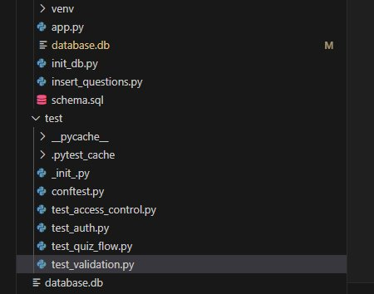
Testing and code coverage
We used Pytest for backend testing
Notes:
Emmanuel

Slide 17
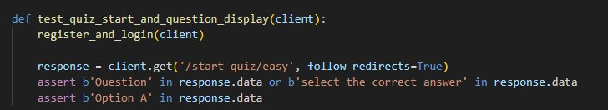
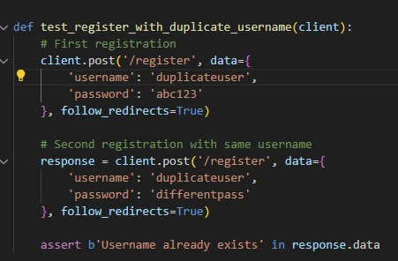
Test simulates quiz start and verifies question rendering.
Validation edge cases like duplicate registration and empty login fields.
Notes:
Emmanuel

Slide 18
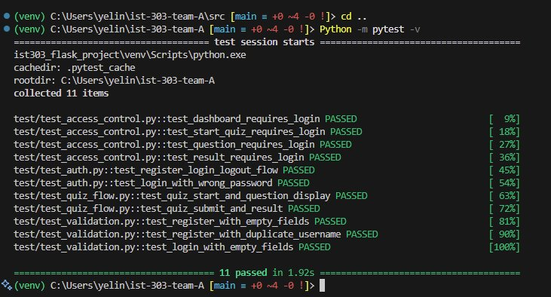
Pytest
We implemented automated testing using pytest.
A total of 11 tests were created across 3 categories:
Access control tests (e.g., login required to access quiz pages)
Authentication tests (Register, Login, Logout Validation)
Quiz flow tests (Question navigation, scoring, results)
All tests passed successfully (11/11) with pytest -v
Notes:
Emmanuel

Slide 19

What we tested?
Manually tested all form inputs, routes and exports
Registration
Login
Quiz Scoring logic
Role-based access
Custom Quiz Filtering
Code coverage includes key routes and logic (80% +)
Notes:
RG

Slide 20

What we learned
Successes:
Developed a fully working Flask quiz app with separate Student and Teacher roles.
Created a dynamic Admin Panel with full CRUD capabilities for quiz management.
Implemented custom quiz generation with filters (difficulty, topic, number of questions).
Built answer toggling logic using Flask routes and session flags.
Enabled Export to PDF and ️ Email Quiz features with clean formatting.
Followed Agile workflow and adapted to real-time client change requests.
Achieved 100% test pass rate across auth, quiz flow, and validation modules.
Notes:
RG

Slide 21

Challenges
Designing the Questions Table & Schema - Creating a normalized and flexible structure for quiz questions with fields like difficulty, topic, and explanations required multiple iterations.
Generating Initial Questions with insert_questions.py - Ensuring question integrity, diverse difficulty levels, and avoiding duplicates during database population took several refinements.
Leaderboard Score Logic - Tracking scores across sessions, maintaining unique usernames, and dynamically updating leaderboard rankings required precise route control.
Session & Route State Mismatch for Answer Toggle - Handling dynamic answer display (show/hide) without breaking route/session continuity needed query param strategies and fallback handling.
PDF Export Instability - PDFs initially failed due to long content, unicode issues, and rendering errors. We fixed this by refining templates and adjusting margins.
Notes:
RG

Slide 22
Lessons learned
Clarify Client Needs Early
Avoid rework by locking requirements upfront.
Use Sessions Wisely
Helps preserve user state and toggle options cleanly.
Evolve UI with Features
User experience should adapt with functionality.
Understand Flask Architecture
We learned how routing, schema, templates, and logic tie together.
Agile Helps Manage Change
Allowed us to respond quickly to client’s new quiz generation request.
Visualize User Flows First
Sketching quiz flow helped us design a smoother experience.
Notes:
RG

Slide 23

Thank you!
Team A

Slide 24
Main user stories used in our projects
User Registration & Login
As a new user, I want to register for an account so I can use the quiz app.
As a student, I want to log in with my credentials so I can take quizzes.
As a teacher, I want to log in with my teacher credentials so I can manage questions.

Slide 25
Main user stories used in our projects
Taking a Quiz (Student Features)
As a student, I want to view available quizzes so I can choose one to take.
As a student, I want to answer multiple-choice questions so I can test my knowledge.
As a student, I want to review my answers before submitting the quiz.
As a student, I want to submit the quiz and see my score instantly.
As a student, I want to see my score compared to others on a leaderboard.
As a student, I want to view a leaderboard to see top performers.
As a student, I want to view my previous quiz attempts so I can track my progress over time.
As a student, I want to see a timer while taking a quiz so I can manage my time.

Slide 26
Main user stories used in our projects
Teacher Admin Features
As a teacher, I want to add new quiz questions so I can grow the question pool.
As a teacher, I want to edit existing questions so I can correct or improve them.
As a teacher, I want to delete questions that are outdated or incorrect.
As a teacher, I want to filter questions by topic or difficulty to find them quickly.
As a teacher, I want to be restricted to teacher-only features to keep student access secure.

Slide 27
Main user stories used in our projects
Custom Quiz Generation (Client Request in Iteration 4)
As a user, I want to generate a quiz with a button click so I don’t need to select questions manually.
As a user, I want to optionally filter generated quizzes by difficulty.
As a user, I want to optionally filter generated quizzes by topic.
As a user, I want to choose how many questions appear in the generated quiz.
As a user, I want to preview the quiz before exporting or sharing.

Slide 28
Main user stories used in our projects
Sharing & Exporting
As a user, I want to toggle showing or hiding answers in the quiz preview.
As a user, I want to export the quiz to PDF so I can print or save it.
As a user, I want to email the quiz for distribution or review.
UI & Project Maintenance
As a user, I want the app to look clean and responsive so I can use it easily on any device.
As a developer, I want clear GitHub documentation and structure so others can understand and run the app.
As a user, I want to be logged out or notified when my session expires for security reasons.

Slide 29
Future pipeline: Hosting CodeQuest online
Render.com
Free tier (500 hrs/month for web services)
Auto-deploys directly from GitHub
Comes with HTTPS and custom domain support
Highly beginner-friendly interface
Steps to Deploy:
Connect to GitHub Repo
Choose "Web Service"
Use commands
pip install –r requirements.txt
gunicorn app:app
Why Render?
Simple to use – no DevOps needed
Smooth deployment process
Great transition from classroom project to real-world app

